Slide 1
Thomson Reuter Performance Classes
Class 1: July 1
Happy System Performance
Class 2: July 8
Advanced Performance Troubleshooting
Class 3: July 14
Advanced Performance “Lab”
Class 4: July 15
System Sizing Presentation
Class 5:July 22
OCPM “Lab”
Class 6: July 29
Open Question and Answer

Slide 2
How to Manage Happy System Performance
Tony Gaddis, Principal Performance Architect

Slide 3
Presentation Focus
The Objective is to help answer the typical performance questions (without having to open a support case):
My application ran fine yesterday, but is slow today; it must be due to storage?
How do I manage my systems so they don’t have performance issues, fall off the cliff?

Slide 4
Agenda
THEORY
Latency
Key Limiting Resource
Key Resource Performance Metrics
In Depth Discussion
“Slow Application” Example
“Performance Management” Example

Slide 5
Latency

Slide 6
Happy Systems - Latency
Latency is the performance SLA with the application
If it is out of the “ordinary”, the phone rings…
Latency is a “perception” more than a “known quantity”
“My report is taking longer to run.”
“My job is not completing on time.”
“It takes forever to complete this command.”

Slide 7
Happy Systems – Latency
Whether storage has a problem or not, the phone may ring anyway
Have to demonstrate the system is operating “normally”
Tracking latency is key
It is not unusual that the latency issue is somewhere other than the storage
Customers must have some Performance Management Tool installed and know how to use it to manage their performance
OCPM, OCI, Harvest/Graphna
KEEP SIMPLE CASES OUT OF SUPPORT
And from taking up a lot of your time

Slide 8
Happy Systems - Latency
What is “ordinary”? - Rule of Thumb for most systems
<5ms reads
Aggregates with Flash Cache or Flash Pool
<2ms reads
SSD aggregates
<2ms writes
<1ms metadata operations
Caveats
Exchange
Tier 3
Storage for Grids

Slide 9
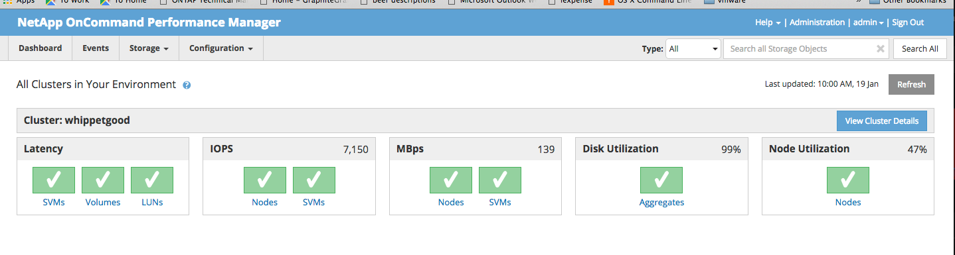
Notes:
The tools we are showing here primarily address performance tracking, trending, and overall performance visualization and to be clear, this is OPM 2.0. That said, don’t be surprised to see that the workflows shown here often require manual correlation of metrics and information from several different pages with the tool (you may need to resort pencil and paper). In this session we are going to show by viewing only a few key metrics using OnCommand tools available today that it is possible to perform simple performance resource capacity planning.
Please keep in mind that as we go through these slide they are captured from a lab environment. A production environment would look fairly different.
Finally, lets be clear that this is not a presentation or demo about performance management tools. We have entire product team for that. There are references at the end of the presentation so you can access the standard collateral on WWW or Field Portal site. This session is laser focused on showing how these performance management tools tie into Tony’s discussion here.
Let’s get started on viewing volume level latency which is a key factor in this discussion. Start at the Performance Manager dashboard. Here you can see overall cluster status and metrics. There are too many different ways to navigate to the volume landing page to cover so we’re simply going to use the the “View Cluster Details” page that takes us to the cluster landing page.

Slide 10
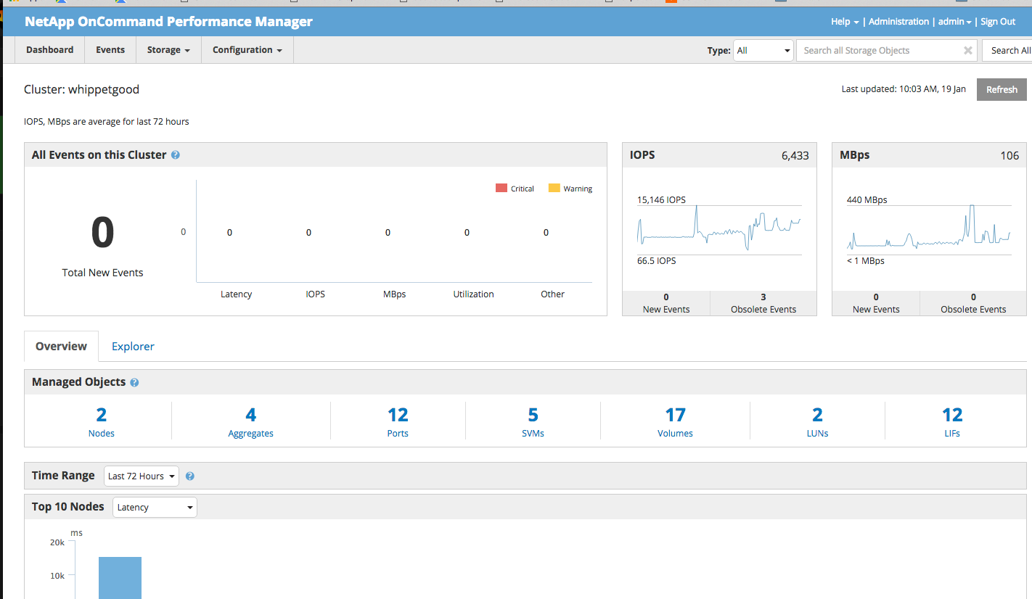
Notes:
The cluster landing page has event and metric summaries over the last 3 days. Just below there is the cluster object inventory.
We’re going to select volume.

Slide 11
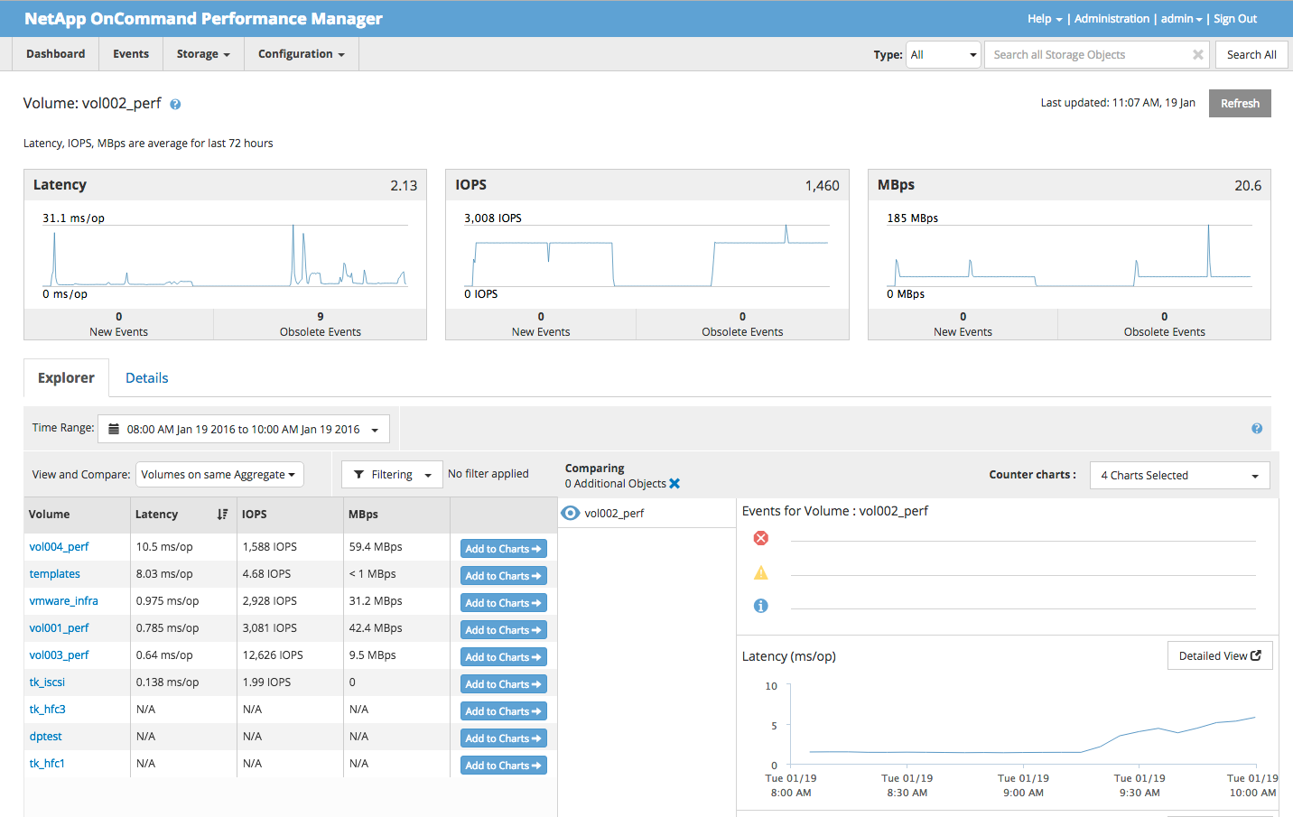
Notes:
We want to navigate to the volume landing page. At first you’ll see volume metric summaries over the last 3 days.
Just below you’ll see the Performance Explorer. Here you can select from a menu of metrics over custom time ranges. Our performance management tools retain data for extensive time periods and we suggest you take advantage of that.
Here we can see the latency metric chart.
Don’t let the simplicity of this chart fool you. Nothing else matters more than what is seen here and this is typically the place to always start.
Viewing the latency of the volume workload where applications reside can save many man-hours, spread out over days and weeks, of work.
Use and leverage the retention database for all it’s worth.
If the Application is reporting slowness, this chart can easily eliminate the storage system as the cause of the issue. View latency during production hours or ranges in question. A flat line or low peak indicates storage is not the source of a given problem or any impending issue. If the latency is higher than expected and trends track with long periods of slow application times during production hours, you may have a storage issue and Tony will cover that in more detail. If there is a perceived issue, it can only be one of a few things: a storage performance problem such as a bug or configuration issue, or a capacity resource shortage such as CPU too high or disk bottleneck. NetApp Technical Support are absolute experts at discovering performance problems (break/fix). We’re here to talk about capacity planning with the single goal to bring latency down to acceptable levels.

Slide 12
Good Latency
How do these latencies occur?
Reads, Typically
40% from memory (caching, prefetching)
40% from flash
20% from disk
Writes
Posting to NVRAM/memory
Metadata
Highly cached in memory

Slide 13

Bad Latencies
How do these latencies occur?
Latency vs. Throughput is a “Hockey Stick”
Good Latency on the “Blade”
Bad Latency on the “Handle”
The “Handle”
Due to Exhausting Resources in the System
Causes Queuing to Occur, Operations Wait
ONTAP key resources
CPU
Disk (highly unlikely in AFF)
Latency
from
Queuing
Resource Utilization and Throughput

Slide 14
Resource Performance Metrics

Slide 15
Performance Measures – CPU, Disks
CPU – node utilization
Today
Max of Avg CPU, B2B CP Margin and Kahuna utilization
Doesn’t cover WAFL thread overutilization well
Future
R&D efforts underway to improve
Aggregates – aggregate utilization
Average of data disk utilization (should be uniform across aggregate)

Slide 16
Deeper Discussion on Node Utilization
AVG_CPU is the average of the non-idle loop time for the cores
Since 8.2.1, CPU_Busy and AVG_CPU are about the same. Prior to 8.2.1, there was an overestimation factor in CPU_Busy
CP Processing – moving write data to the disks
Periodically triggered process
If the system write load gets too high, a CP won’t complete prior to next CP trigger
Back-to-Back CPs occur, write latency increases dramatically
B2B CP Margin estimates headroom before this occurs
In the past Kahuna (Serial) has been a major bottleneck in WAFL processing, especially CIFS (prior to 8.3)
At about 60% utilization, CPU queuing occurs in WAFL processing

Slide 17
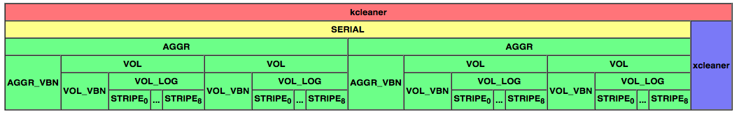
WAFL “Bento”
8.1-Newer WAFL

Slide 18
ONTAP Disk Behavior
Over time data is randomly distributed all across the disk media surface
Every disk IO looks like moderately-sized random access
Rules of Thumb
SAS random access time ~7ms
Gives ~120 IOP/s per data spindle
SATA random access time ~10ms
Gives ~80 IOP/s per data spindle
IOs can be queued on disk and software storage layer, latency = queue depth * access time
Disk Reality SSPF (“Shortest Seek Position First”)
Disk Queuing - BAD

Slide 19
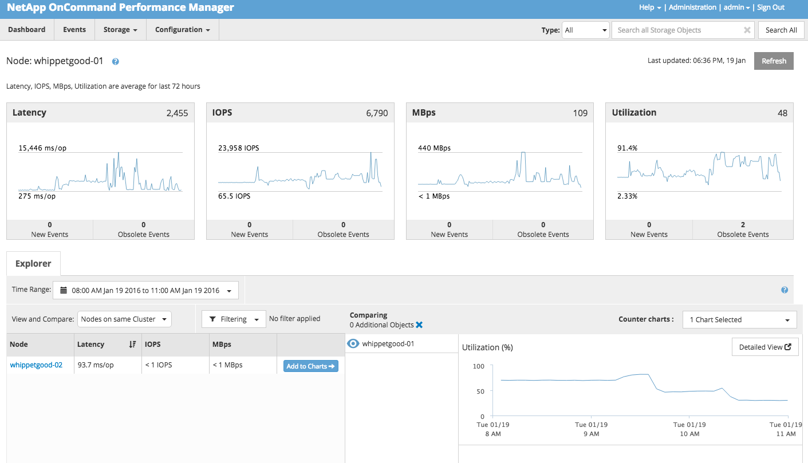
Notes:
As Tony said, as resource consumption increases, latency geometrically increases (the “handle).
We’re starting out on the node landing page. You can navigate to the node landing page from the dashboard very easily so we won’t be going over that again.
Here we see the familiar metric summaries and the performance explorer.
In this case we selected a time range of interest, typically production hours, and selected the node utilization charts. The point of this slide is to show that we can visualize node resource consumption trends or over narrow time ranges.

Slide 20
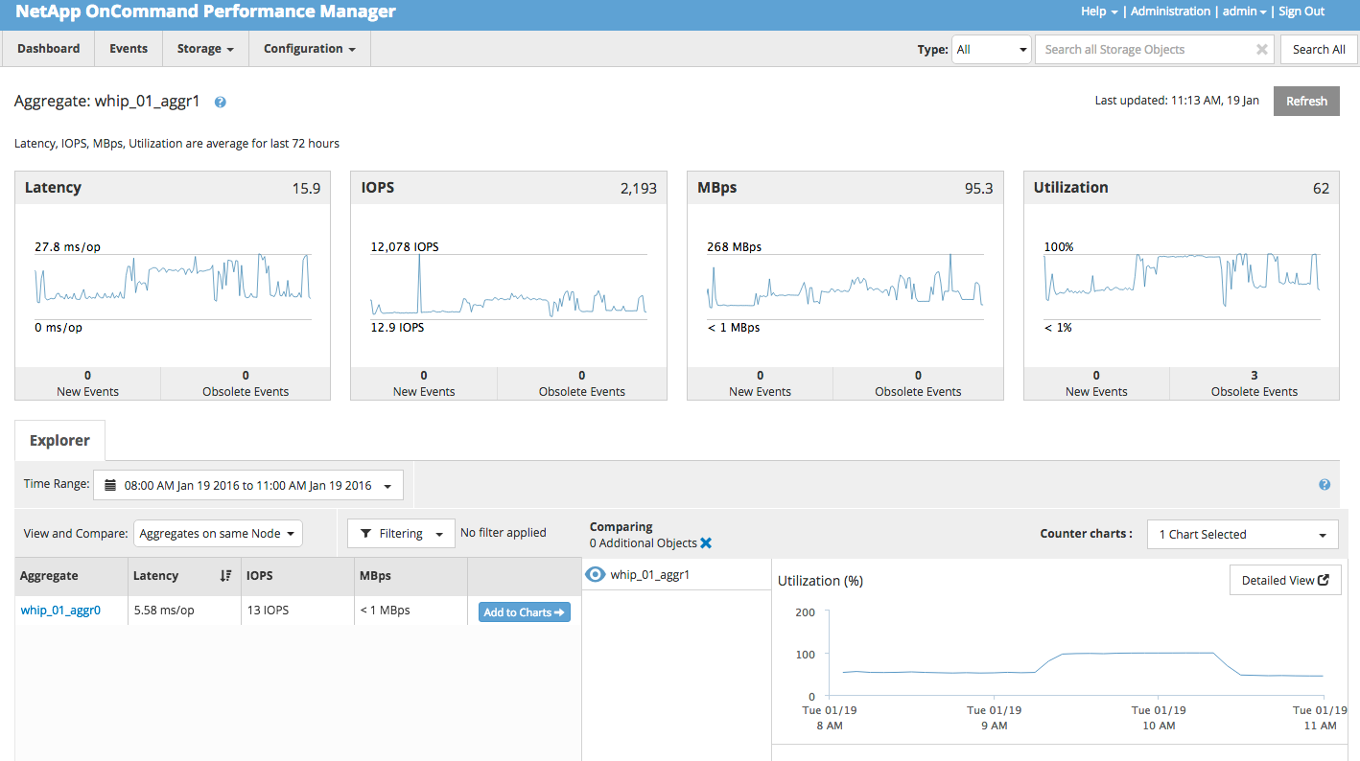
Notes:
We can do the same with aggregate objects.

Slide 21
“Slow Application Performance” Example

Slide 22
Performance Question #1
Bad application performance due to storage?
Does storage latency show correlation with slow application?
If “No”, start a broader discussion to look at the whole system: servers, networking
Probably will need help here
If “Yes”
Is there a correlation with node utilization or aggregate utilization
Look at high IOP/throughput volumes
Is there a correlating change?
Identify highest IOP volumes

Slide 23
Remediation – Stop the Pain, Fast
Either node or aggregate overutilization – fastest approaches
Was this due to change in application workload
Can clamp with QoS, while customer discusses situation with application owner
Was this due to accumulated workload or system aging (more on this one later)?
VolMove is your friend (assuming customer has recognized the need for performance capacity buffer, more in next question)

Slide 24
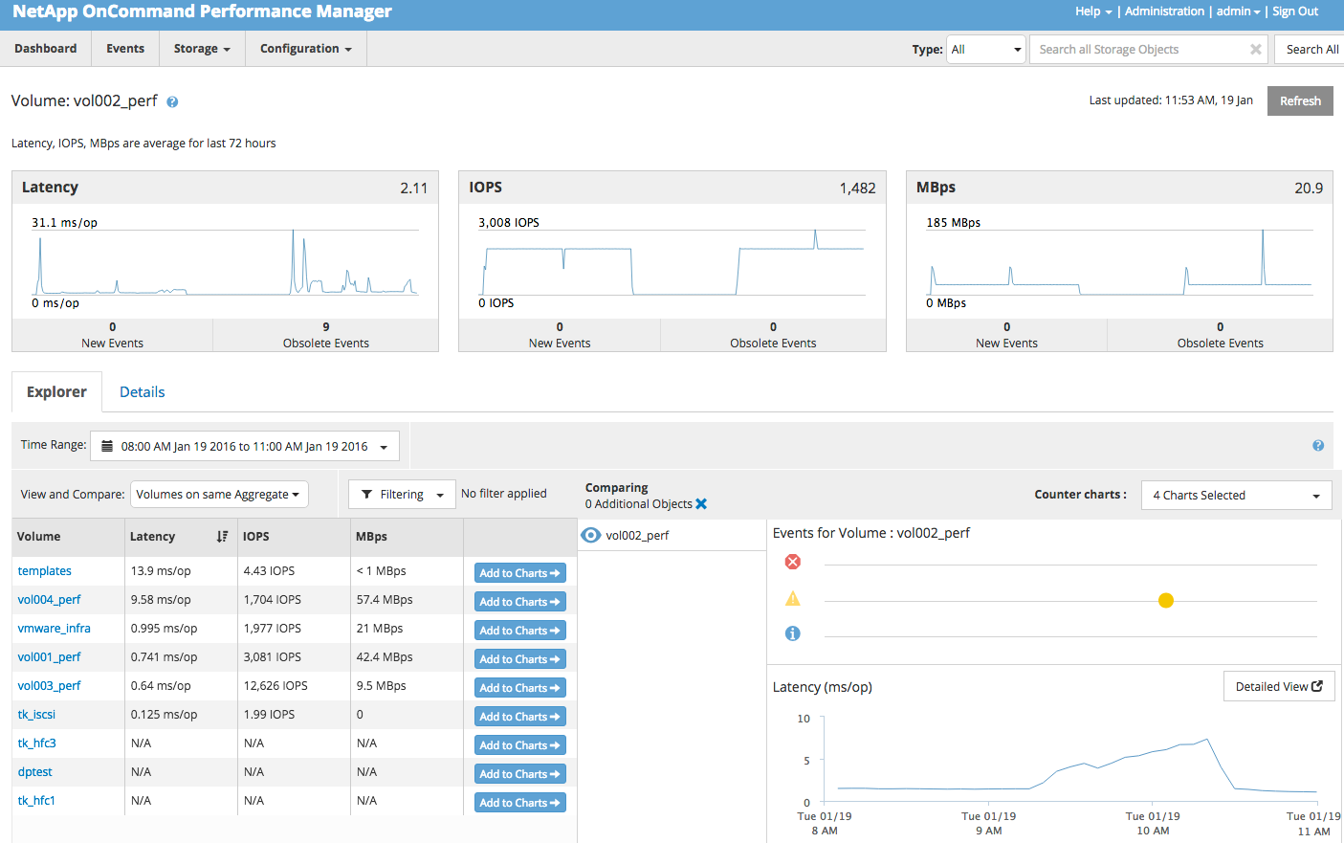
Notes:
Scenario: Latency event reported on volume “vol002_perf” around 10AM on 01/19
We already know how to view metrics over time ranges of interest. Here we’ve narrow the time range and see a latency event that correlates with application slowness.
Note increase in volume latency from around 1 msec to 7 msecs.

Slide 25
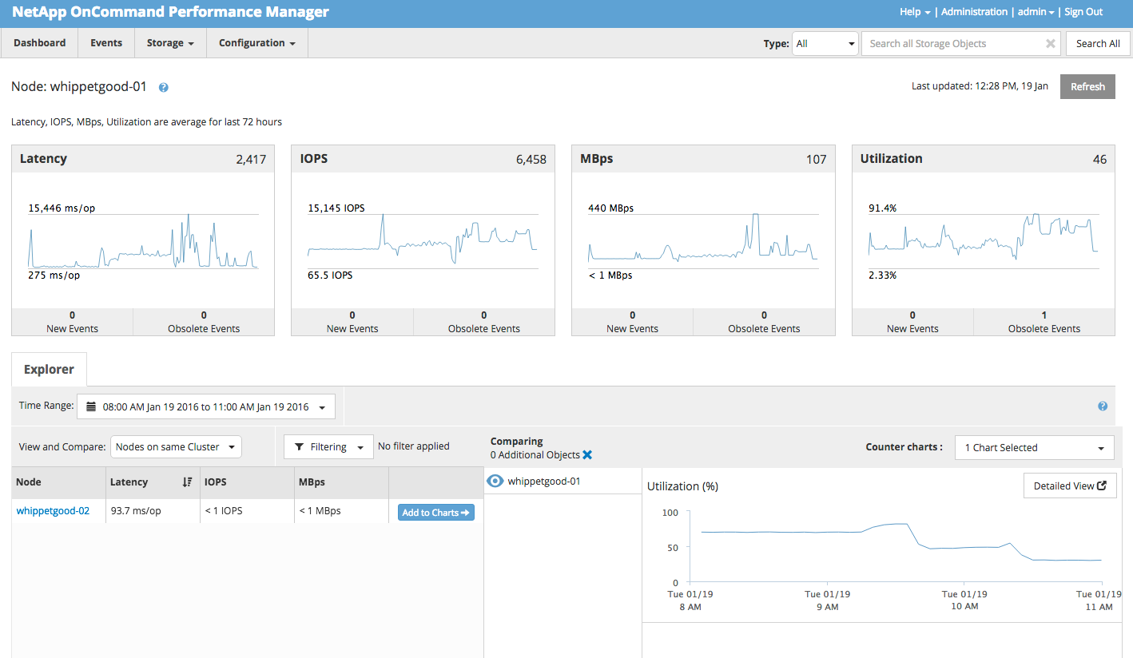
Notes:
Navigate to node landing page and view node utilization (as described earlier) during same time range (around 10AM).
And we can see that CPU utilization actually decreases during the time of the reported event.
Lets check the aggregate next.

Slide 26
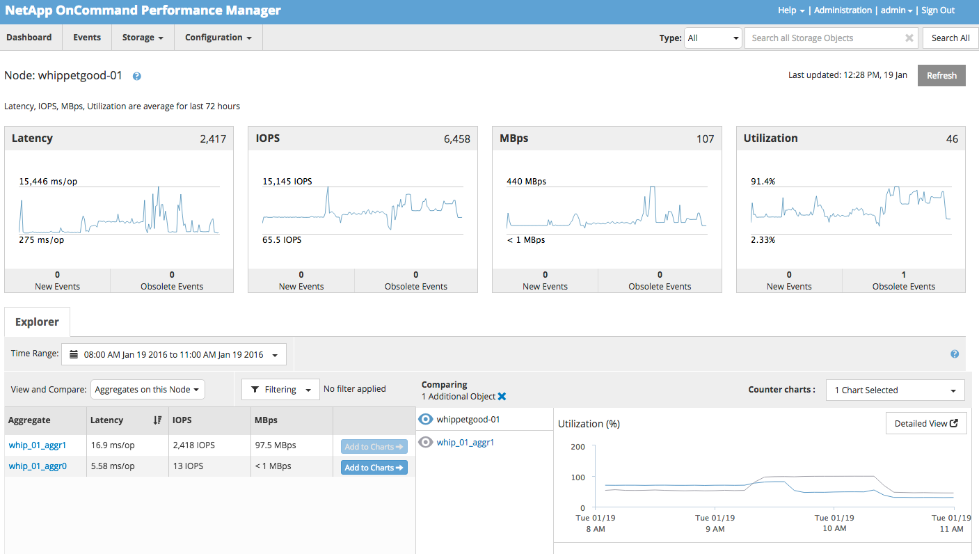
Notes:
Using Performance Manager we can visualize node and aggregate utilization on the same chart.
Note that during the time range of interest CPU utilization drops, as we observed earlier, while disk utilization increases. So we’ve confirmed that there is correlation between the latency event and disk resource consumption on the node.
Now lets attempt to correlate workload behavior with this increase in resource consumption.

Slide 27
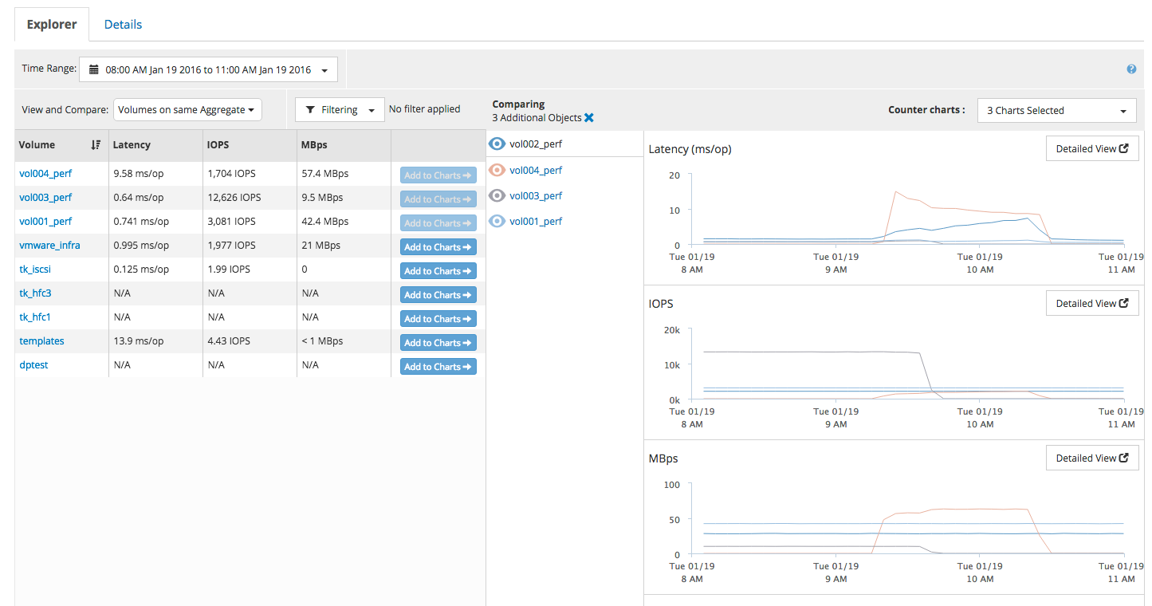
Notes:
In the screen shot we’re on a volume landing page using Performance Manager explorer. From the volume landing page we can add additional volumes from the same aggregate. Here we’ve placed other volumes of interest stack their metrics on the charts.
Recall vol002 had the latency event during the time range of interest. We can see that there was additional latency on another volume, vol004, but we do not see any correlating IOPS increase. In fact, quite the opposite. In this instance however, it’s fairly easy to identify the volume workload consuming the disk resource. The volume vol004_perf (pinkish line) shows a sharp increase in throughput (MBps) in the bottom chart. Note that using IOPS alone to identify would not have helped here.

Slide 28
“Performance Management” Example

Slide 29
Happy Systems – Happy Customers, Happy SEs
How do you manage your system to maintain happy performance?
During “user hours” overutilization
Rule of Thumb – When node utilization greater than 85%, a very high likelihood CPU queuing occurring, and user visible latency impact
Rule of Thumb – When aggregate disk busy (utilization) greater than 50% for Flash Cache or Flash Pool aggregate, a very high likelihood of higher latency on disk IOs and user visible latency impact

Slide 30
Use OPM, OCI, Harvest/Graphna
How do you manage your system to maintain happy performance?
During “user hours”
For an SLA of no latency impact during TO
Maintain HA combined Node Utilization less than 100%
For an SLA where latency impact during TO is an acceptable risk
Maintain HA combined Node Utilization less than 150%
Maintain aggregate utilization less than 50%
Balance workload across nodes/aggregates

Slide 31
Customer #1 Performance Management
A cup of coffee and an OCI report

Slide 32
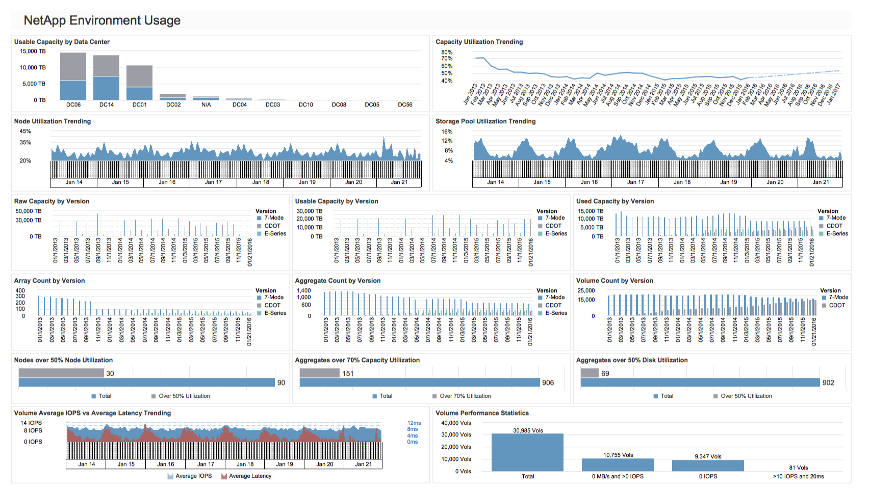

Slide 33
Other Resources
NetApp Storage Performance Primer http://www.netapp.com/us/media/tr-4211.pdf
OnCommand Performance Manager Product page http://www.netapp.com/us/products/management-software/performance-manager.aspx
OnCommand Performance Manager Field Portal https://fieldportal.netapp.com/content/206742?assetComponentId=206841
OnCommand Insight Product Page http://www.netapp.com/us/products/management-software/oncommand-insight/
OnCommand Insight Field Portal https://fieldportal.netapp.com/content/206678?assetComponentId=206776

Slide 34
Thank you.

